Slide 1
MEDICAL DATA HISTORY
Project ID :- PTID-CDA-MAY-25-450
📘 Report:
This Medical Data History project offers a detailed analysis of a healthcare database by leveraging SQL to extract meaningful insights from interconnected datasets, including patient records, doctor information, and hospital admissions. It tackles a series of 35 real-world SQL queries designed to simulate practical scenarios in medical data handling. These tasks involve operations such as filtering records, performing complex joins, aggregating values, handling NULLs, and executing conditional logic.
The project explores key trends such as common diagnoses, provincial patient distribution, allergy data, and height/weight ranges. It also deals with practical database constraints like permission errors during updates and schema mismatches—such as resolving the relationship between attending_doctor_id and doctor_id. Overall, this project enhances critical SQL skills essential for data analysis roles, particularly in the healthcare and public health sectors, where precise and reliable data interpretation is vital.

Slide 2
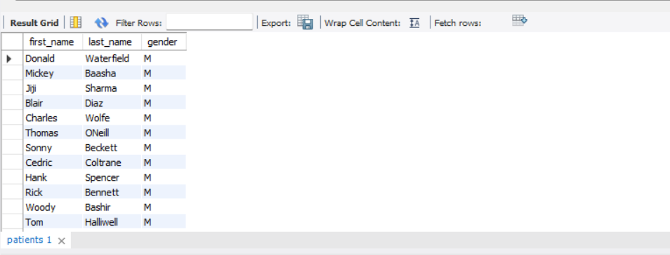
QUERY 1: Show first name, last name, and gender of patients who's gender is 'M'
SELECT first_name,last_name,gender
FROM patients
WHERE gender='M’;

Slide 3
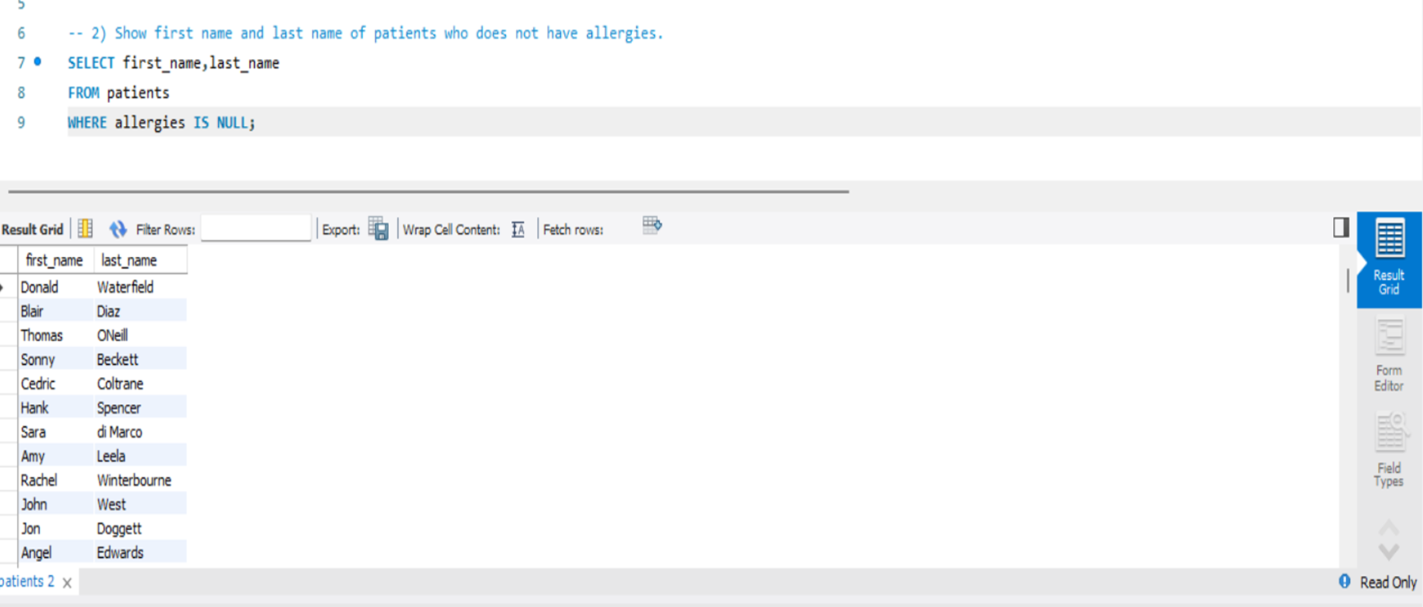
QUERY 2: Show first name and last name of patients who does not have allergies.
SELECT first_name,last_name
FROM patients
WHERE allergies IS NULL;

Slide 4
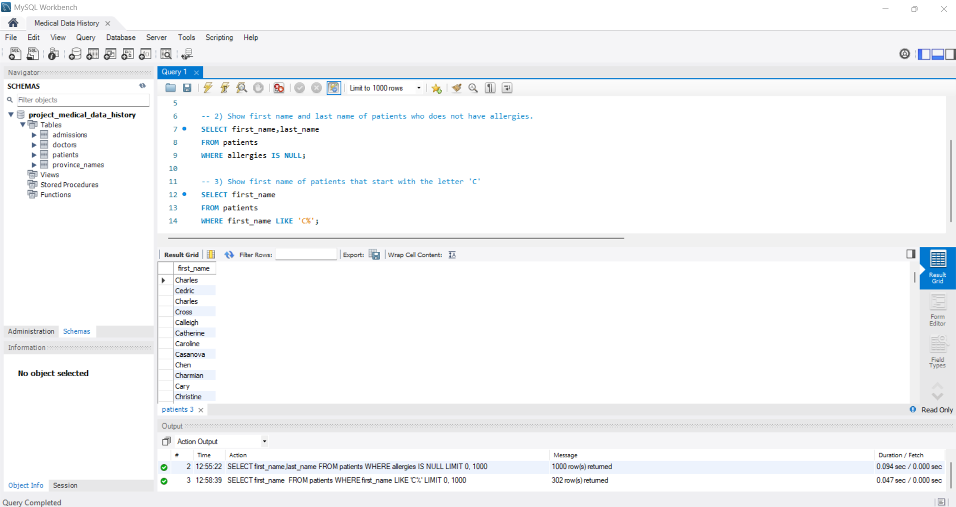
QUERY 3: Show first name of patients that start with the letter 'C'
SELECT first_name
FROM patients
WHERE first_name LIKE 'C%’;

Slide 5
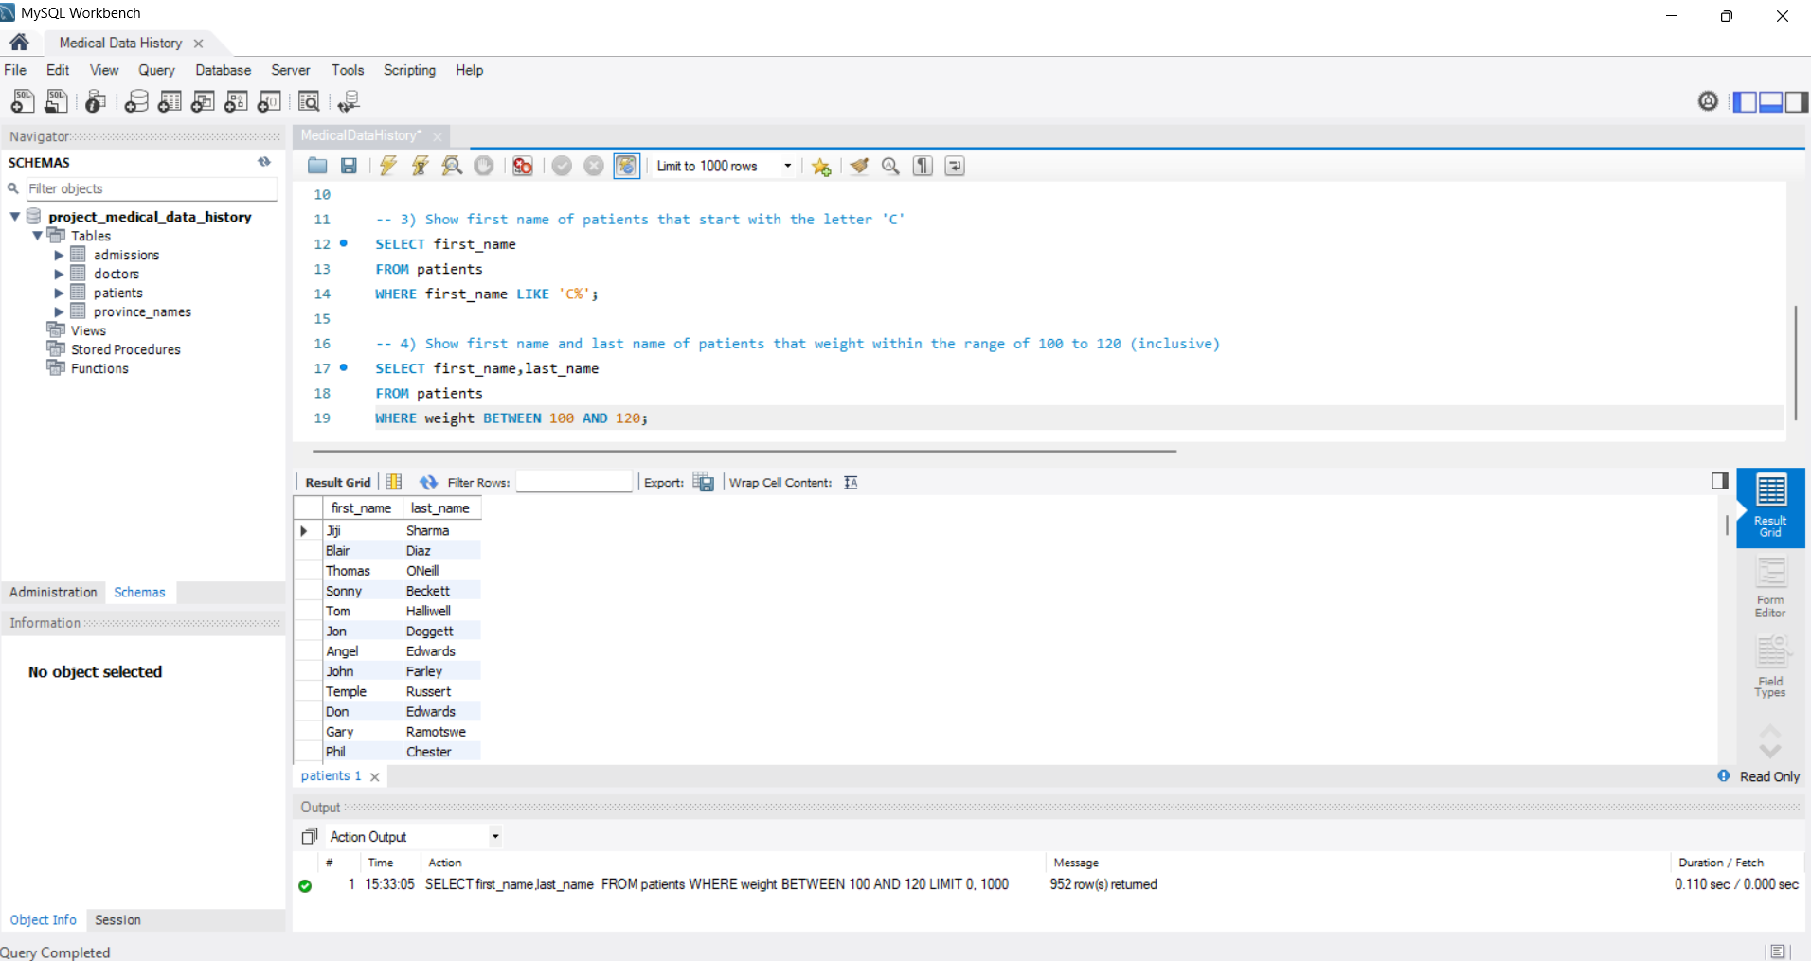
QUERY 4: Show first name and last name of patients that weight within the range of 100 to 120 (inclusive)
SELECT first_name, last_name
FROM patients
WHERE weight BETWEEN 100 AND 120;

Slide 6
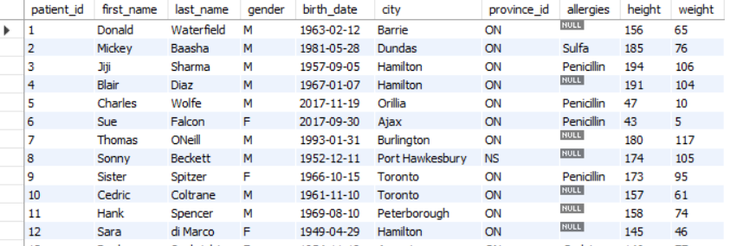
QUERY 5: Update the patients table for the allergies column. If the patient's allergies is null then replace it with 'NKA'
UPDATE patients
SET allergies = 'NKA'
WHERE allergies IS NULL;

Slide 7
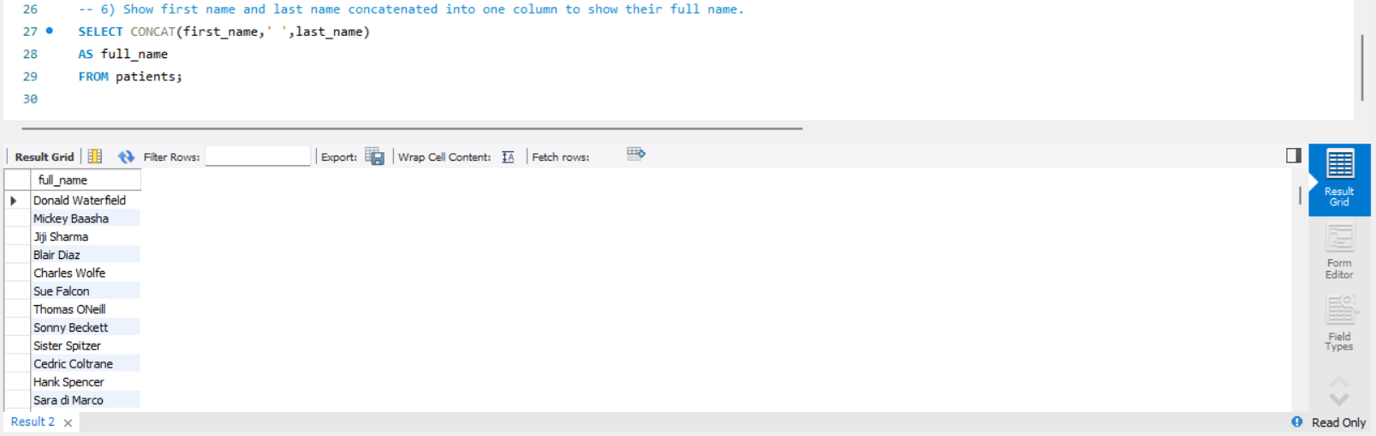
QUERY 6: Show first name and last name concatenated into one column to show their full name.
SELECT CONCAT(first_name, ' ', last_name) AS full_name
FROM patients;

Slide 8
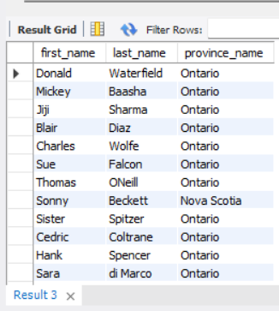
QUERY 7: Show first name, last name, and the full province name of each patient.
SELECT p.first_name, p.last_name, pr.province_name
FROM patients p
JOIN province_name pr ON p.province_id = pr.province_id;

Slide 9
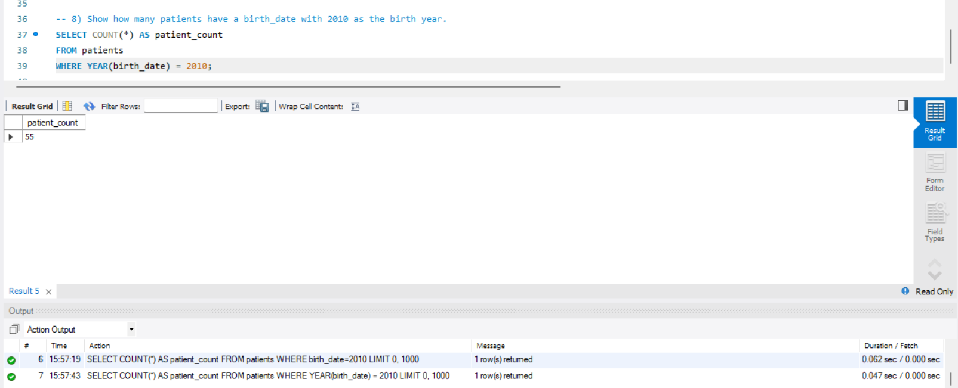
QUERY 8: Show how many patients have a birth_date with 2010 as the birth year.
SELECT COUNT(*) AS patient_count
FROM patients
WHERE YEAR(birth_date) = 2010;

Slide 10
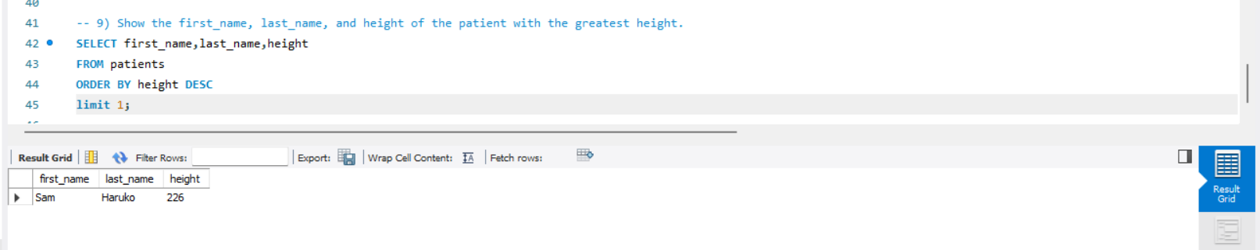
QUERY 9: Show the first_name, last_name, and height of the patient with the greatest height.
SELECT first_name, last_name, height
FROM patients
ORDER BY height DESC
LIMIT 1;

Slide 11
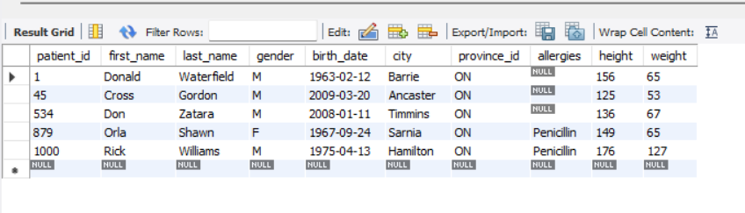
QUERY 10: Show all columns for patients who have one of the following patient_ids: 1, 45, 534, 879, 1000
SELECT *
FROM patients
WHERE patient_id IN (1, 45, 534, 879, 1000);

Slide 12
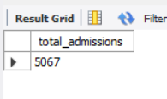
QUERY 11: Show the total number of admissions
SELECT COUNT(*) AS total_admissions
FROM admissions;

Slide 13
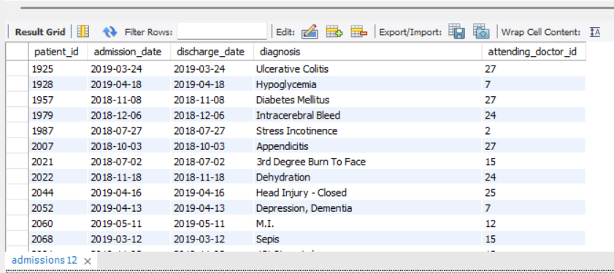
QUERY 12: Show all the columns from admissions where the patient was admitted and discharged on the same day.
SELECT *
FROM admissions
WHERE admission_date = discharge_date;

Slide 14
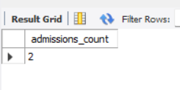
QUERY 13: Show the total number of admissions for patient_id 579.
SELECT COUNT(*) AS admissions_count
FROM admissions
WHERE patient_id = 579;

Slide 15
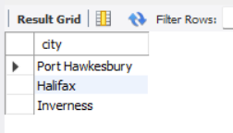
QUERY 14: Based on the cities that our patients live in, show unique cities that are in province_id 'NS'
SELECT DISTINCT city
FROM patients
WHERE province_id = 'NS';

Slide 16
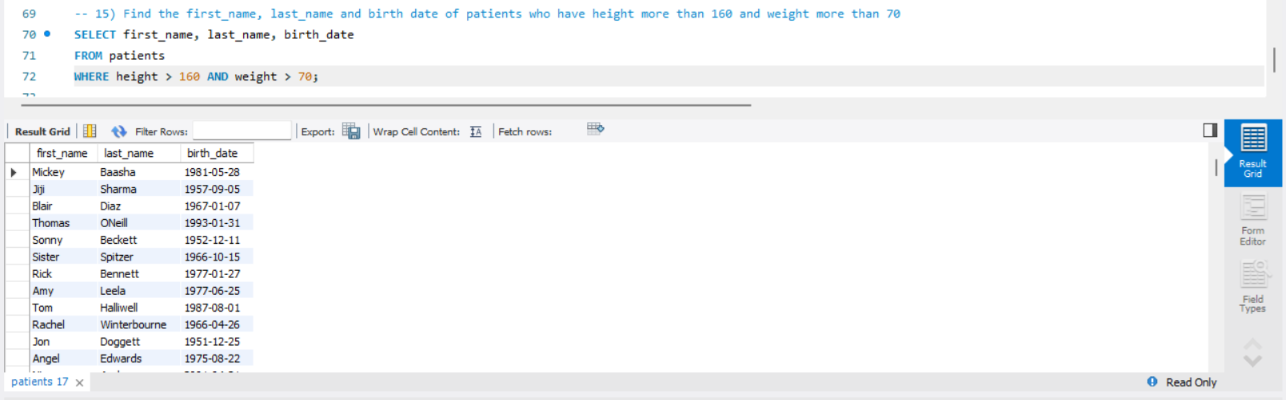
QUERY 15: Find the first_name, last_name and birth date of patients who have height more than 160 and weight more than 70
SELECT first_name, last_name, birth_date
FROM patients
WHERE height > 160 AND weight > 70;

Slide 17
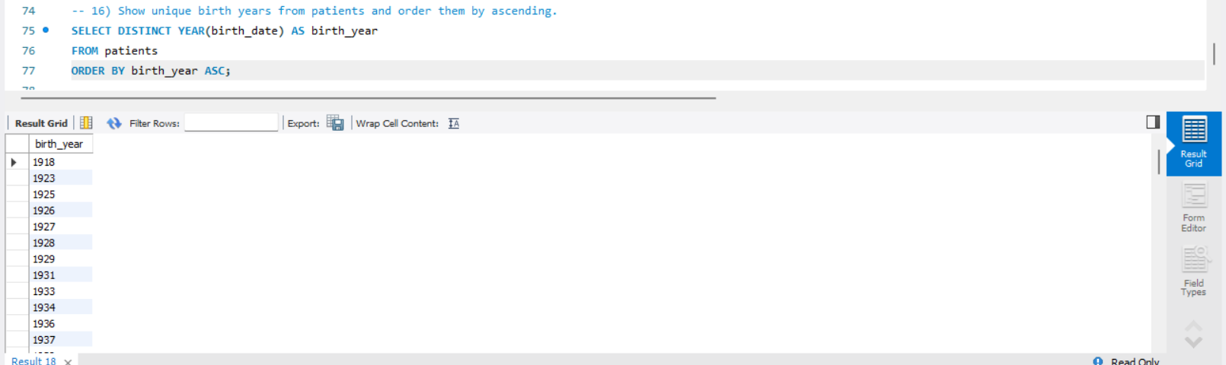
QUERY 16: Show unique birth years from patients and order them by ascending.
SELECT DISTINCT YEAR(birth_date) AS birth_year
FROM patients
ORDER BY birth_year ASC;

Slide 18
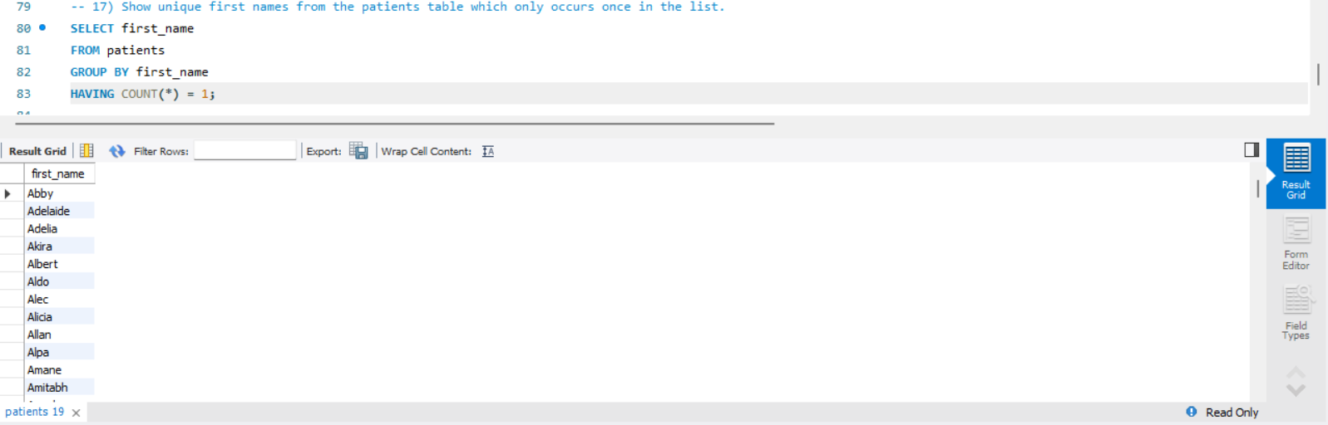
QUERY 17: Show unique first names from the patients table which only occurs once in the list.
SELECT first_name
FROM patients
GROUP BY first_name
HAVING COUNT(*) = 1;

Slide 19
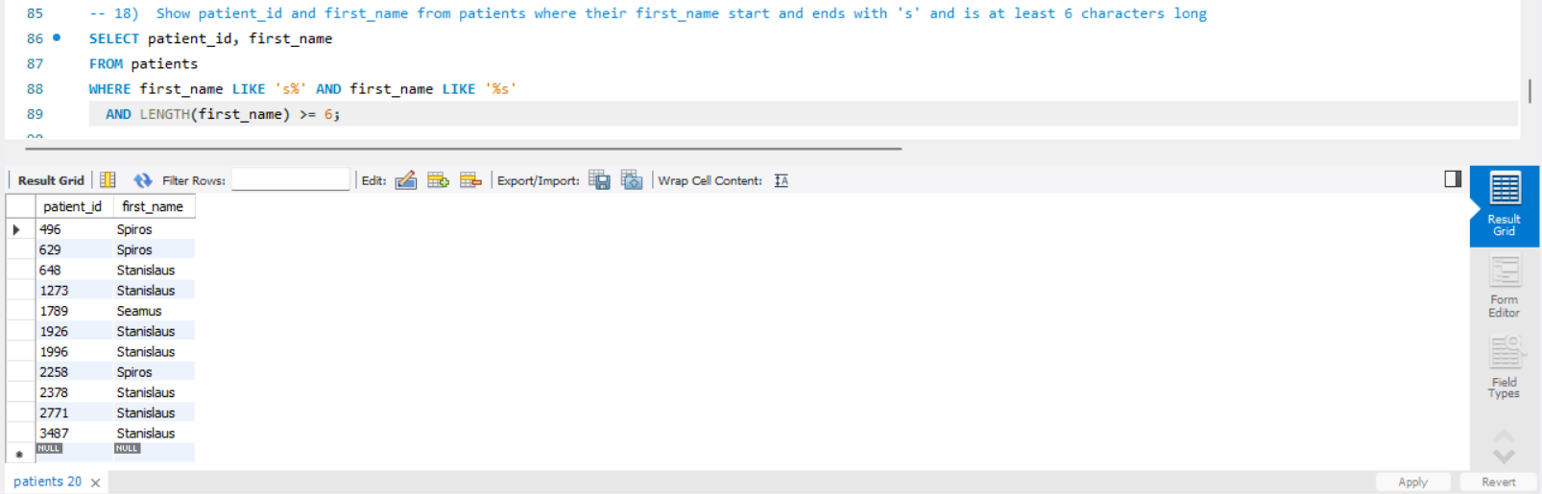
QUERY 18: Show patient_id and first_name from patients where their first_name start and ends with 's' and is at least 6 characters long.
SELECT patient_id, first_name
FROM patients
WHERE first_name LIKE 's%' AND first_name LIKE '%s'
AND LENGTH(first_name) >= 6;

Slide 20
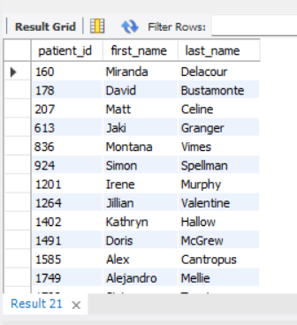
QUERY 19: Show patient_id, first_name, last_name from patients whose diagnosis is 'Dementia'.
SELECT p.patient_id, p.first_name, p.last_name
FROM patients p
JOIN admissions a ON p.patient_id = a.patient_id
WHERE a.diagnosis = 'Dementia’;

Slide 21
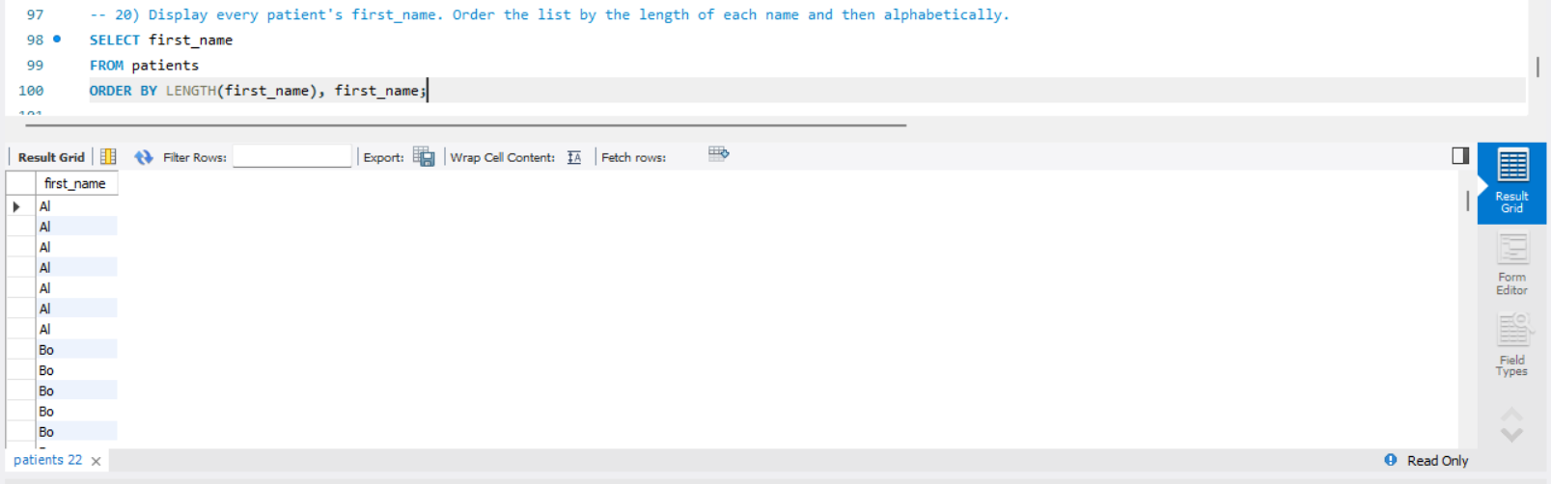
QUERY 20: Display every patient's first_name. Order the list by the length of each name and then alphabetically.
SELECT first_name
FROM patients
ORDER BY LENGTH(first_name), first_name;

Slide 22
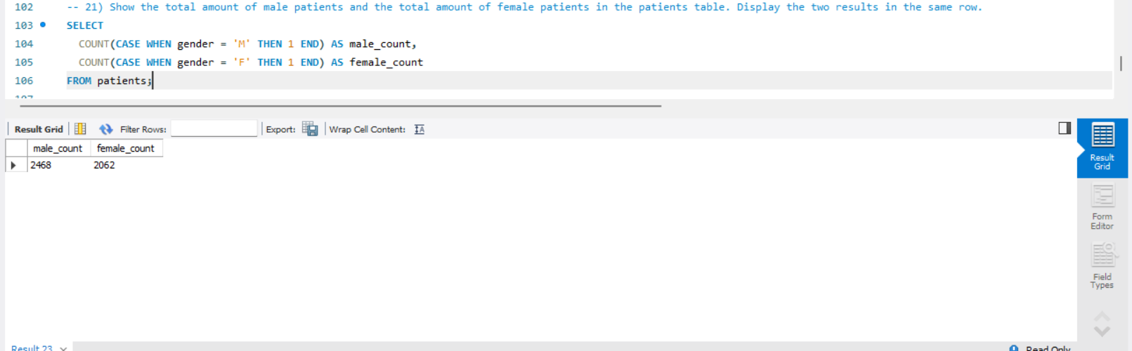
QUERY 21: Show the total amount of male patients and the total amount of female patients in the patients table. Display the two results in the same row.
SELECT
COUNT(CASE WHEN gender = 'M' THEN 1 END) AS male_count,
COUNT(CASE WHEN gender = 'F' THEN 1 END) AS female_count
FROM patients;

Slide 23
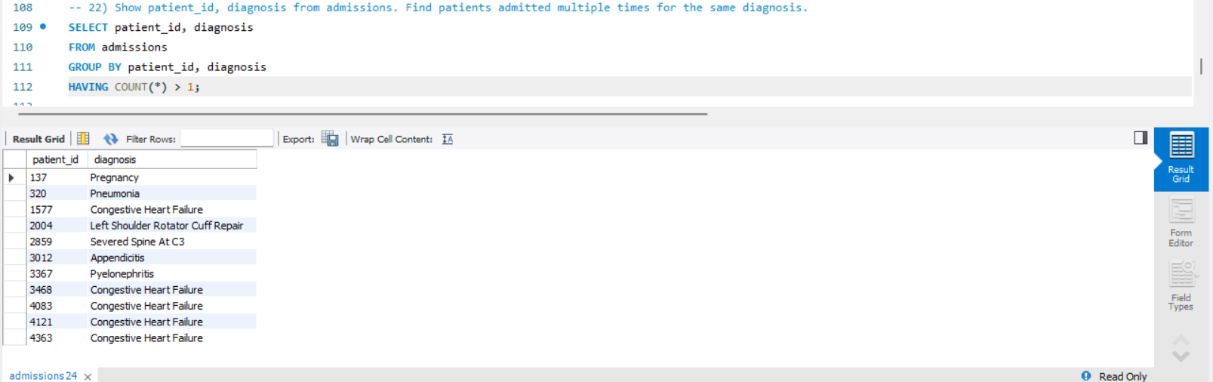
QUERY 23: Show patient_id, diagnosis from admissions. Find patients admitted multiple times for the same diagnosis.
SELECT patient_id, diagnosis
FROM admissions
GROUP BY patient_id, diagnosis
HAVING COUNT(*) > 1;

Slide 24
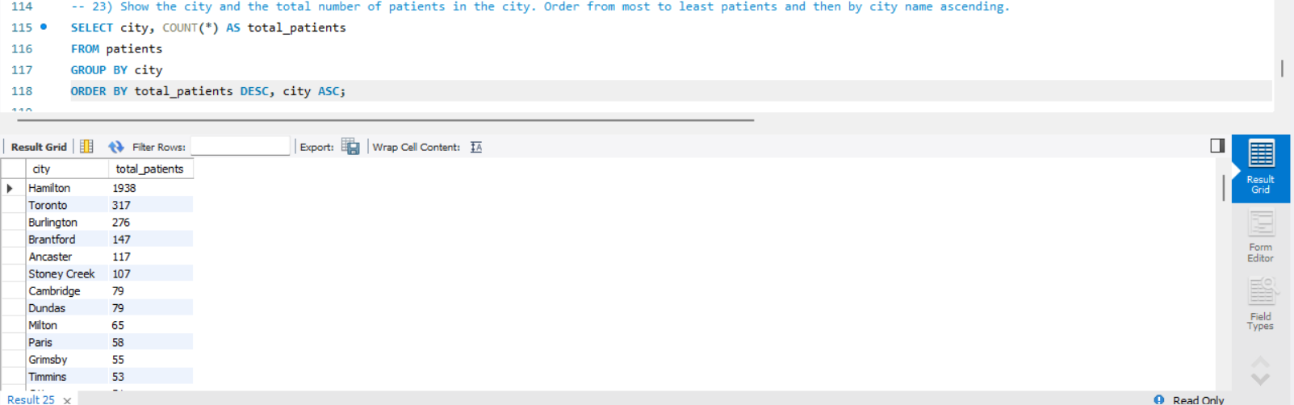
QUERY 24: Show the city and the total number of patients in the city. Order from most to least patients and then by city name ascending.
SELECT city, COUNT(*) AS total_patients
FROM patients
GROUP BY city
ORDER BY total_patients DESC, city ASC;

Slide 25
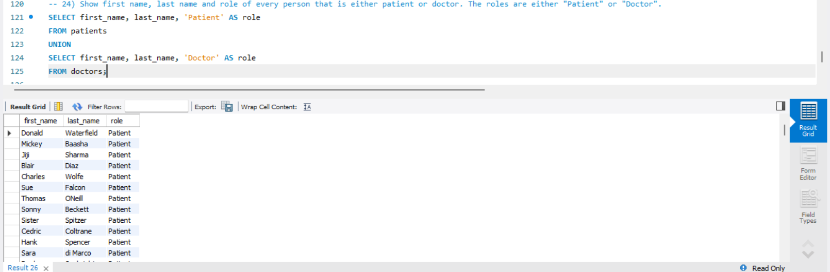
QUERY 25: Show first name, last name and role of every person that is either patient or doctor. The roles are either "Patient" or "Doctor".
SELECT first_name, last_name, 'Patient' AS role
FROM patients
UNION
SELECT first_name, last_name, 'Doctor' AS role
FROM doctors;

Slide 26
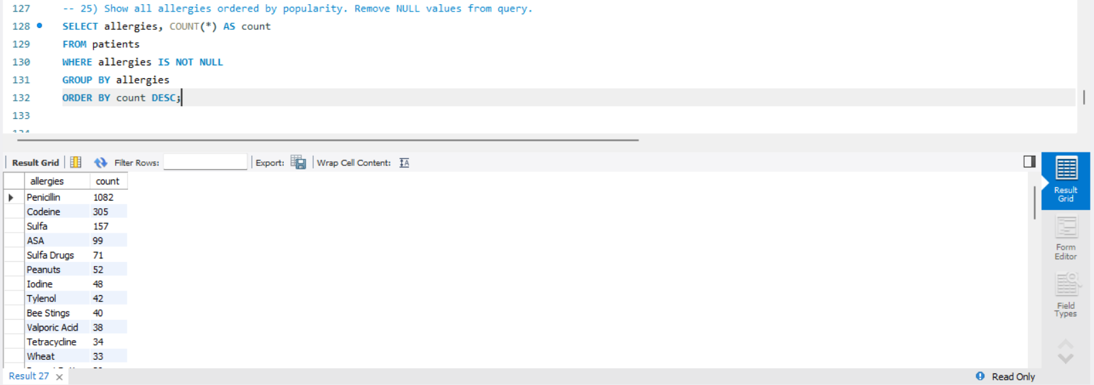
QUERY 26: Show all allergies ordered by popularity. Remove NULL values from query.
SELECT allergies, COUNT(*) AS count
FROM patients
WHERE allergies IS NOT NULL
GROUP BY allergies
ORDER BY count DESC;

Slide 27
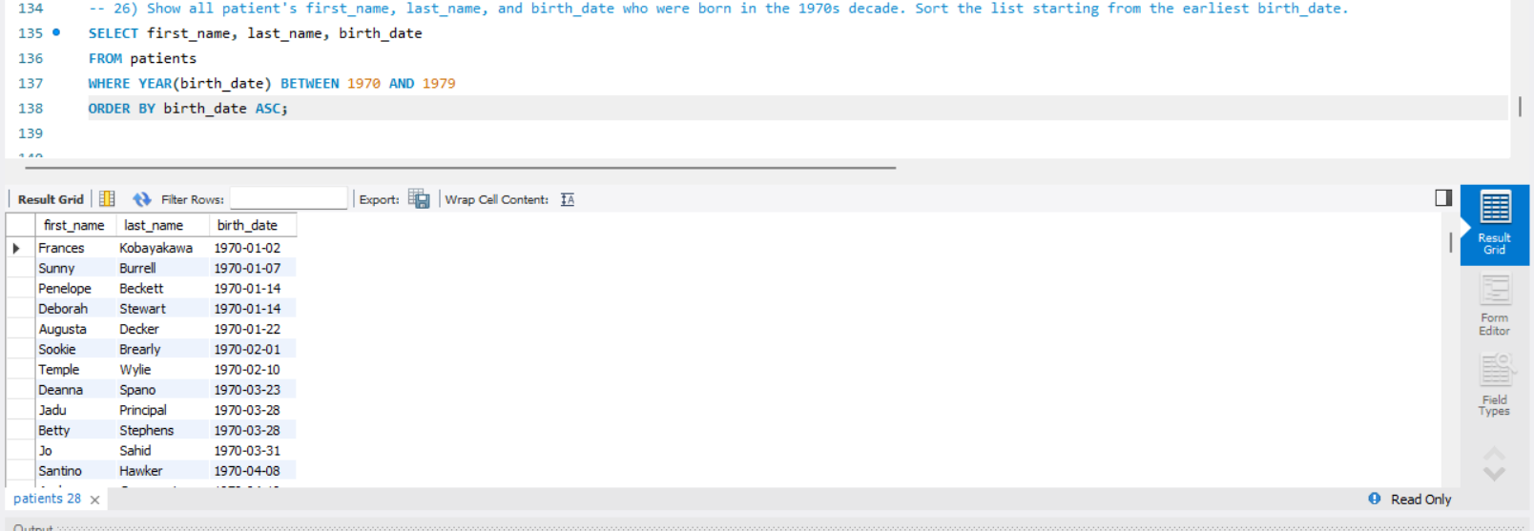
QUERY 27: Show all patient's first_name, last_name, and birth_date who were born in the 1970s decade. Sort the list starting from the earliest birth_date.
SELECT first_name, last_name, birth_date
FROM patients
WHERE YEAR(birth_date) BETWEEN 1970 AND 1979
ORDER BY birth_date ASC;

Slide 28
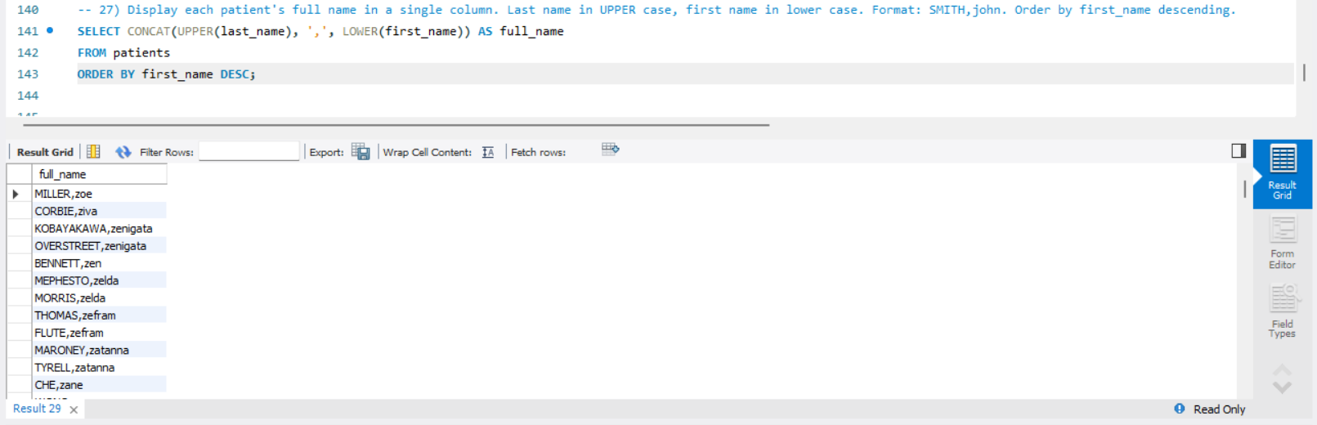
QUERY 28: Display each patient's full name in a single column. Last name in UPPER case, first name in lower case. Format: SMITH,john. Order by first_name descending.
SELECT CONCAT(UPPER(last_name), ',', LOWER(first_name)) AS full_name
FROM patients
ORDER BY first_name DESC;

Slide 29
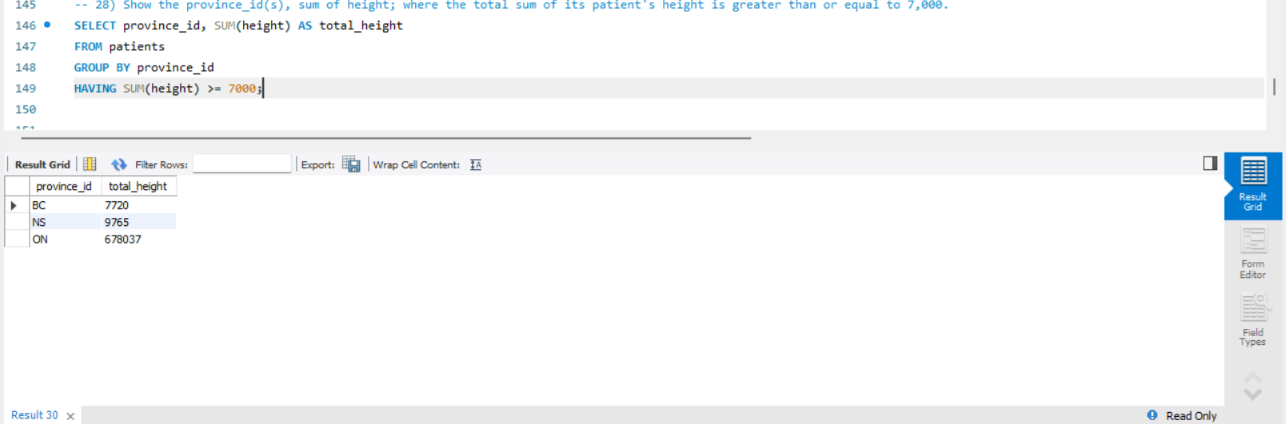
QUERY 29: Show the province_id(s), sum of height; where the total sum of its patient's height is greater than or equal to 7,000.
SELECT province_id, SUM(height) AS total_height
FROM patients
GROUP BY province_id
HAVING SUM(height) >= 7000;

Slide 30
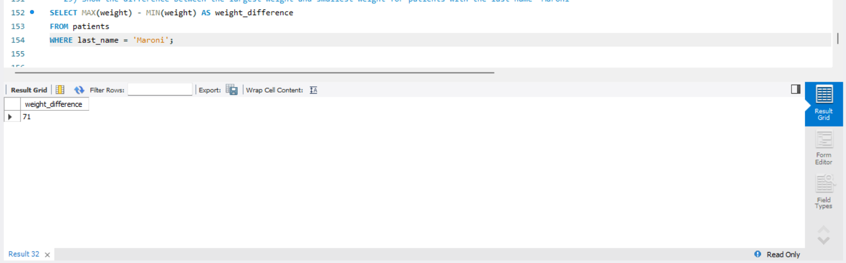
QUERY 30: Show the difference between the largest weight and smallest weight for patients with the last name 'Maroni'
SELECT MAX(weight) - MIN(weight) AS weight_difference
FROM patients
WHERE last_name = 'Maroni’;

Slide 31
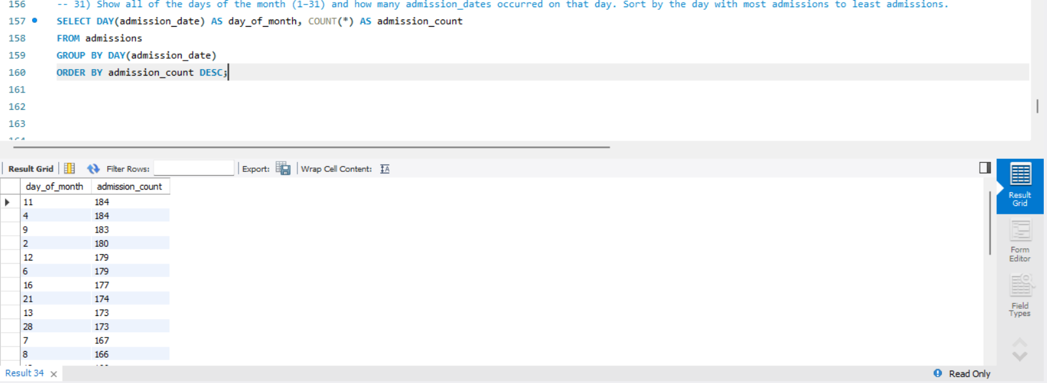
QUERY 31: Show all of the days of the month (1–31) and how many admission_dates occurred on that day. Sort by the day with most admissions to least admissions.
SELECT DAY(admission_date) AS day_of_month, COUNT(*) AS admission_count
FROM admissions
GROUP BY DAY(admission_date)
ORDER BY admission_count DESC;

Slide 32
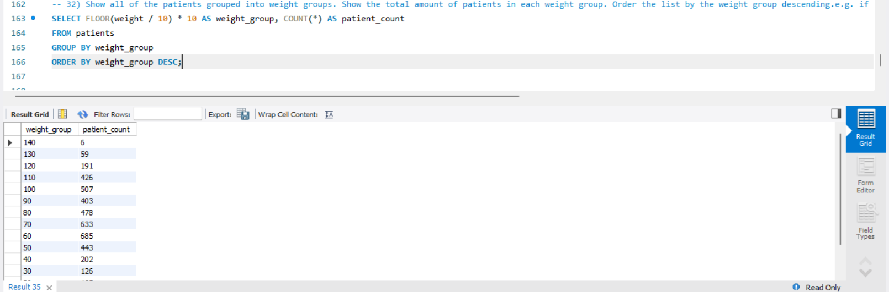
QUERY 32: Show all of the patients grouped into weight groups. Show the total amount of patients in each weight group. Order the list by the weight group descending.
SELECT FLOOR(weight / 10) * 10 AS weight_group, COUNT(*) AS patient_count
FROM patients
GROUP BY weight_group
ORDER BY weight_group DESC;

Slide 33
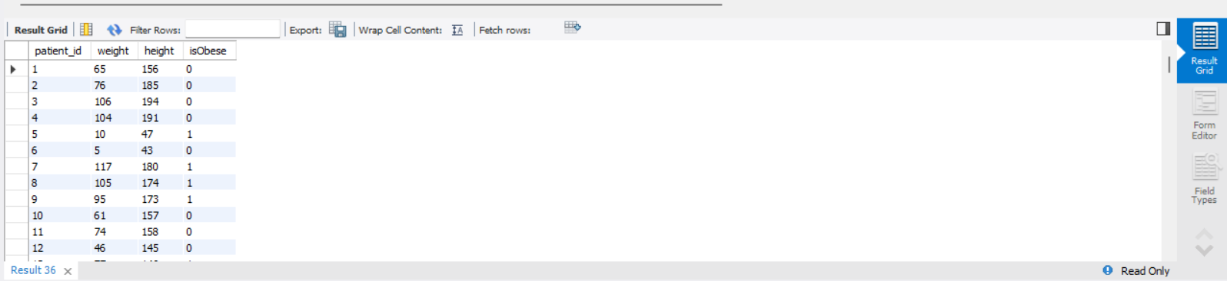
QUERY 33: Show patient_id, weight, height, and is_obese column. The is_obese column should display “Yes” if the patient’s BMI is over 30 and “No” otherwise. BMI = weight (kg) / (height (m)^2).
SELECT patient_id, weight, height,
CASE
WHEN (weight / POWER(height/100, 2)) > 30 THEN 'Yes'
ELSE 'No'
END AS is_obese
FROM patients;

Slide 34
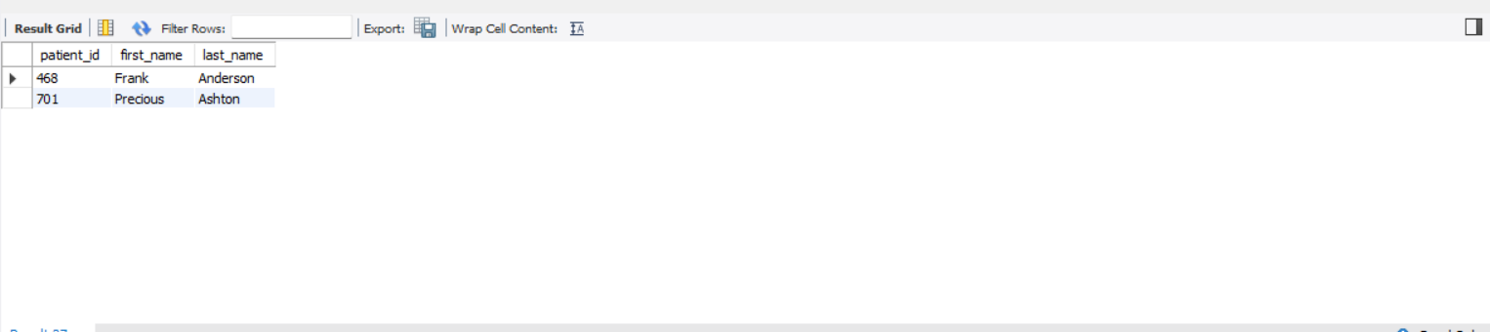
QUERY 34: Show all patients who have been diagnosed with “Epilepsy” and were treated by a doctor named “Lisa”.
SELECT p.patient_id, p.first_name, p.last_name
FROM patients p
JOIN admissions a ON p.patient_id = a.patient_id
JOIN doctors d ON a.attending_doctor_id = d.doctor_id
WHERE a.diagnosis = 'Epilepsy' AND d.first_name = 'Lisa’;

Slide 35
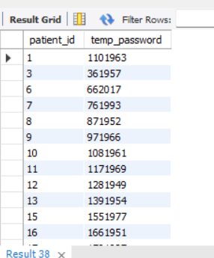
QUERY 35: Generate a temporary password for all patients. Format: lowercase last name + birth year + last 4 digits of phone number
SELECT p.patient_id,CONCAT(p.patient_id,LENGTH(p.last_name),YEAR(p.birth_date))
AS temp_password
FROM patients p JOIN admissions a ON p.patient_id = a.patient_id
GROUP BY p.patient_id,p.last_name,p.birth_date;

